Slide 1
Time zone handling
Zoe zhou
Notes:
Customer service

Slide 2
outline
Definition
Representing Time Values in Data Structures
Strategies
Conclusion

Slide 3
What is time zone?
UTC Offset-All time zones have, as their basis, an offset from Coordinated Universal Time (UTC) by a whole number of hours (UTC−12 to UTC+14) .

Slide 4
What is time zone?
DST-Some times zones include rules for observing daylight saving time (DST or Summer time)
DST varies from country to country (not to mention locality-to-locality) and often has "special one-off" changes to accommodate special events.

Slide 5
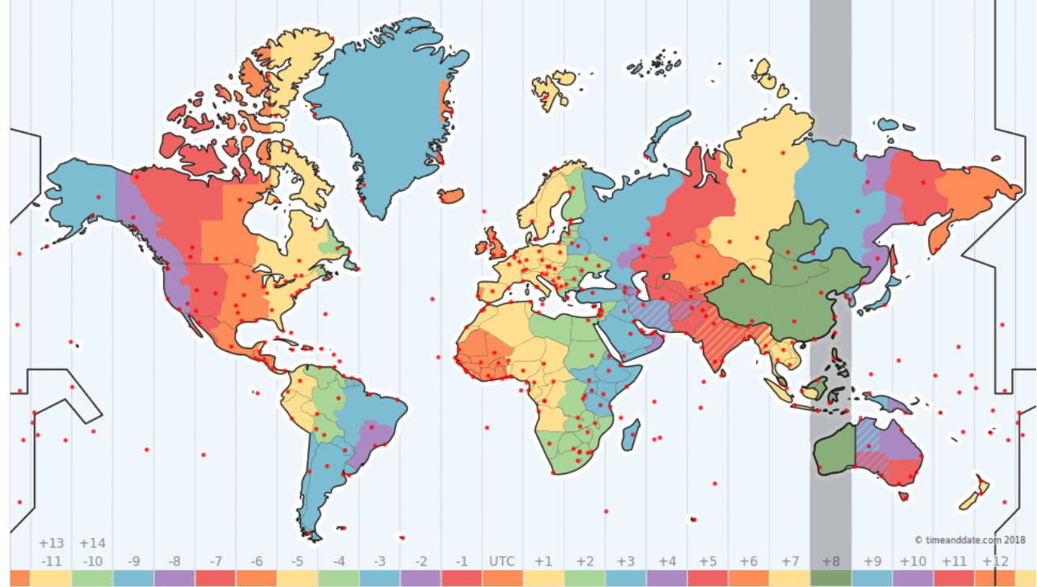
Notes:
25 time zones, +8 in China
2 hours faster in Australia
If in summer time, 3 hours earlier.

Slide 6
Representing Time Values in Data Structures
Field-Based Time
Field-based time divides observed or local time into separate field values such as year, month, day, hour, minute, second, etc.
E.g. 2018-12-18T09:40:32
Notes:
Dived time into separate field values, year month

Slide 7
Representing Time Values in Data Structures
Incremental Time
A way of representing time in computers that is based on a progression of fixed integer units that increase monotonically from a specific point in time (called the "epoch").
Incremental time is not usually seen directly by users, but is mapped to observed time for human consumption.
E.g. 1465621816590 11 June, 2016 at 6.10am BST)
Notes:
Most programming languages and operating environments provide or use incremental time for working with time values.

Slide 8
Representing Time Values in Data Structures
Floating Time
Some time values are not related to a specific moment in incremental time named “floating times”.
Floating times are not attached and should never be attached to a particular time zone.
E.g. User’s birth date, a list of official holidays

Slide 9
Strategies of time zone handling
Timestamp
Moment-Particular moment
Event time-International event and local envent
Relative time-Related to an article or a blog post
Future time-Booking flight ticket
Notes:
Different timestamp
Moment: it always points a particular moment, like time of a solar eclipse happened.
Event time: this can be sub divided into international event or a local event, eg: the time when a international olympic game happens or a television show happening at particular local timezone.
Relative time: the time related to a article or a blog post like 5 mins ago, 1 hr ago etc.,
Future time: like booking a flight ticket, which should take care of day light saving.

Slide 10
Strategies of time zone handling
Decide whether to store your date time
relative to a time zone(UTC with offset)-User entered fields
universal time(UTC without any offset-Auto generated
literally-No need geographical support
Notes:
When comes with the user entered fields in some cases you may need to store both UTC time and the offset relative to their local timezone.
All the auto generated timestamps like created at, posted at, edited at etc., which always refers to an exact moment in time, that should be stored in a universal time(UTC without any offset) which will not get affected by day light saving.
not need a geographical support, in those cases you can literally store the user entered timestamp and no need to worry about UTC or timezone

Slide 11
Strategies of time zone handling
Display base on
The person who enters the value: e.g. in case of flight booking
User who views the data e.g. Inbox, Blog post
Config or setting
Notes:
in case of flight booking its always recommended to show the flight timing same as the person’s locale who booked it.
in case of Blog post, Inbox its best to show in relative terms like 3 mins ago, 2 hrs ago, convert to their local time zone and display it.
if the application is used with in a same location, then we can get the time zone from a config file to display the value.
Most of the application converts their timestamp to UTC before storing it in database, so that you can convert it back to user timezone while displaying.

Slide 12
Conclusion
What is UTC and DST
Representing Time Values in Data Structures( Incremental time, field based time and floating time)
Strategies decide how to store and how to display in different cases.

Slide 13
Thanks

